Slide 1
Mathematics For Computing – 4 (22MAT230) DMFFT: Improving The Generation Quality Of Diffusion Models Using Fast Fourier Transform
By
Kiruthika (CB.SC.U4AIE24329)
MITHUL PRANAV ( CB.SC.U4AIE24331)
MAALIKA P ( CB.SC.U4AIE24332 )
RITHAN S ( CB.SC.U4AIE24348 )

Slide 2
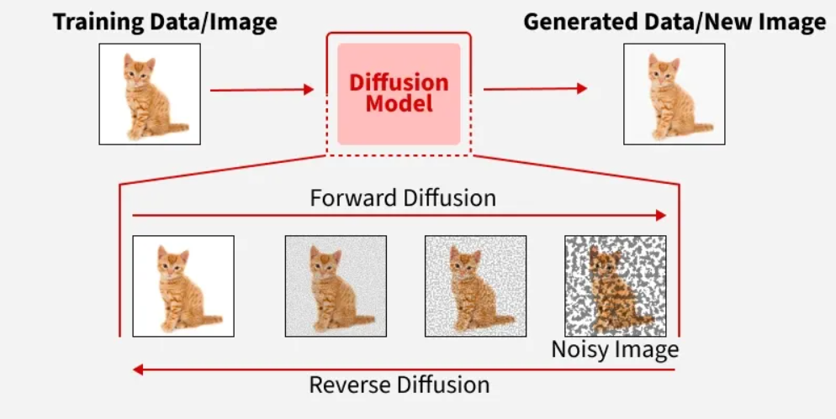
Introduction
Diffusion Models
Diffusion models are generative models that learn to reverse a diffusion process to generate data. The diffusion process involves gradually adding noise to data until it becomes pure noise.
Through this process, a simple distribution is transformed into a complex data distribution in a series of small incremental steps.
Essentially, these models operate as a reverse diffusion phenomenon where noise is introduced to the data in a forward manner and removed in a reverse manner to generate new data samples.
By learning to reverse this process, diffusion models start from noise and gradually denoise it to produce data that closely resembles the training examples.

Slide 3
Problem Statement
Current Diffusion Models (such as Stable Diffusion) face a critical trade-off between generation quality and computational cost. Improving visual quality, specifically text alignment, structural layout, and fine textures, typically requires:
Massive increases in parameters and network size.
Costly re-training or fine-tuning of complex attention mechanisms and conditional guidance.
Excessive smoothing of textures during the denoising process, often seen in existing frequency modulation methods, which fail to transform backbone features into the frequency domain or apply amplitude and phase adjustments

Slide 4
Objective
The primary objective of this research is to propose DMFFT (Diffusion Models using Fast Fourier Transform), to enhance generation quality
Specifically, the method aims to:
Integrate Frequency Domain Analysis into the Sampling Process: Decompose U-Net feature extraction results from both the backbone and lateral skip connections into their frequency, amplitude, and phase components
Optimise U-Net Feature Fusion: Target the CrossAttnUpBlock (Cross-Attention Upsampling Block) as the primary entrance for optimisation to ensure high-level semantic features and low-level spatial features fuse correctly
Provide Precise Visual Control: Establish suggested scaling intervals for high-frequency features (1.2 to 1.4) to optimise semantics and brightness, and low-frequency features (0 to 0.8) to improve clarity and texture
Improve Efficiency: Utilise the Fast Fourier Transform (FFT) to maintain a low time complexity (O(N log N) ), ensuring that quality improvements add negligible inference time without increasing memory consumption

Slide 5
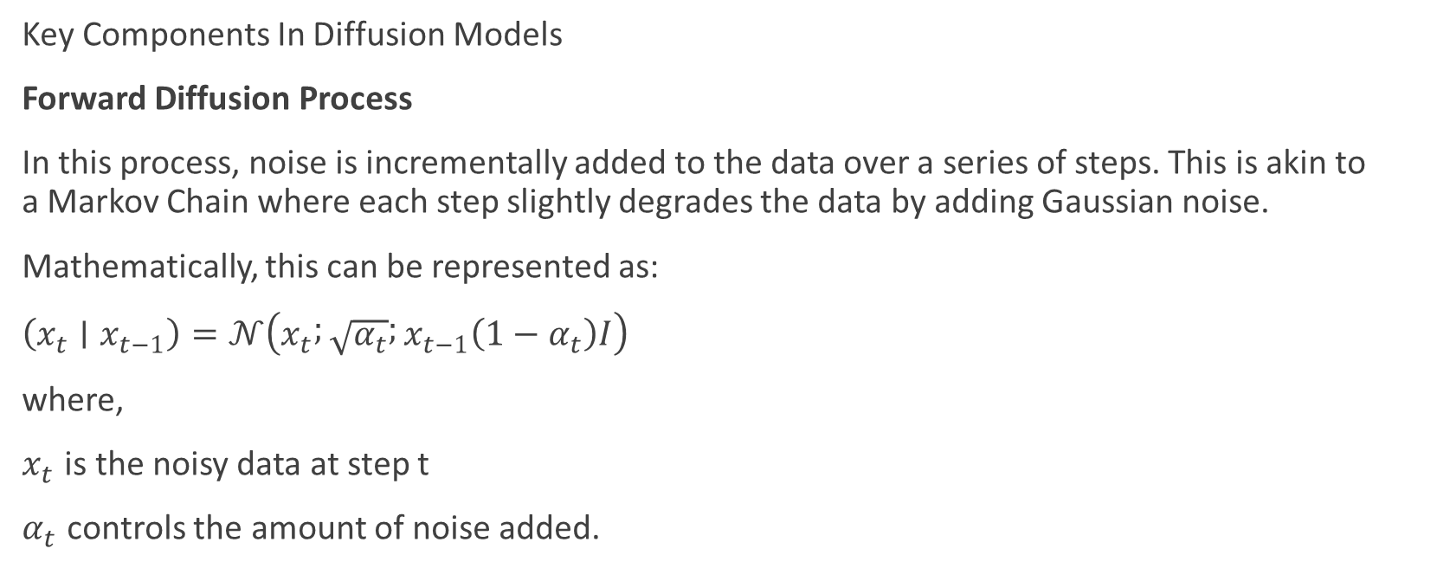
Methodology
Key Components In Diffusion Models
Forward Diffusion Process
In this process, noise is incrementally added to the data over a series of steps. This is akin to a Markov Chain where each step slightly degrades the data by adding Gaussian noise.
Mathematically, this can be represented as:
$\left(x_{t}∣x_{t−1}\right)=𝒩\left(x_{t} ; \sqrt{α_{t}} ; x_{t−1}\left(1−α_{t}\right)I\right)$
where,
$x_{t}$ is the noisy data at step t
$α_{t}$ controls the amount of noise added.

Slide 6
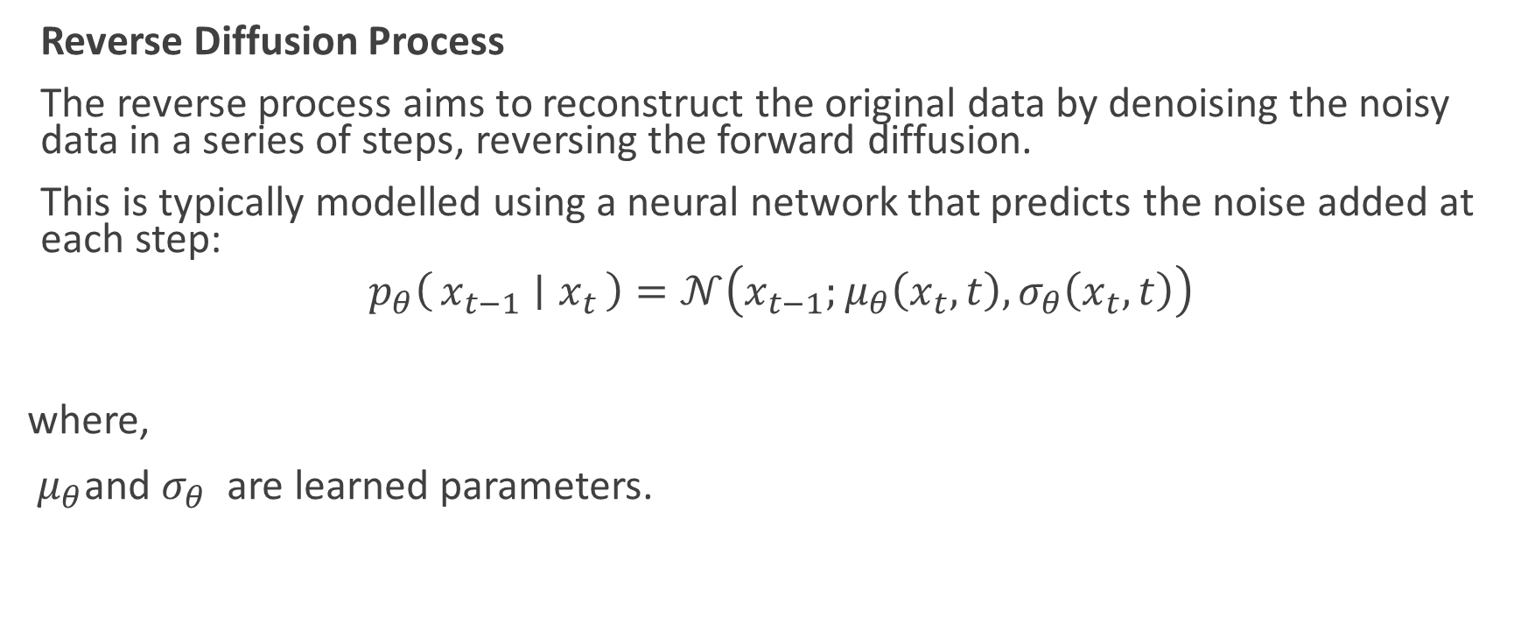
Reverse Diffusion Process
The reverse process aims to reconstruct the original data by denoising the noisy data in a series of steps, reversing the forward diffusion.
This is typically modelled using a neural network that predicts the noise added at each step:
$$p_{θ}\left(x_{t−1} ∣ x_{t}\right)=𝒩\left(x_{t−1};μ_{θ}\left(x_{t},t\right),σ_{θ}\left(x_{t},t\right)\right)$$
where,
$μ_{θ}\text{and} σ_{θ}$ are learned parameters.
​

Slide 7
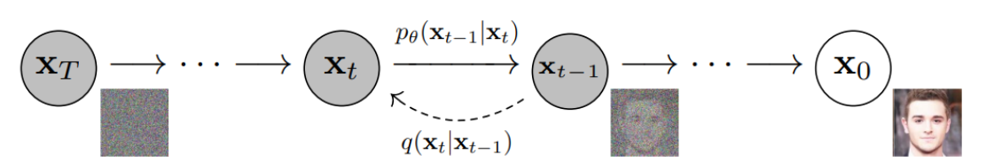
Forward Diffusion
Reverse Diffusion

Slide 8
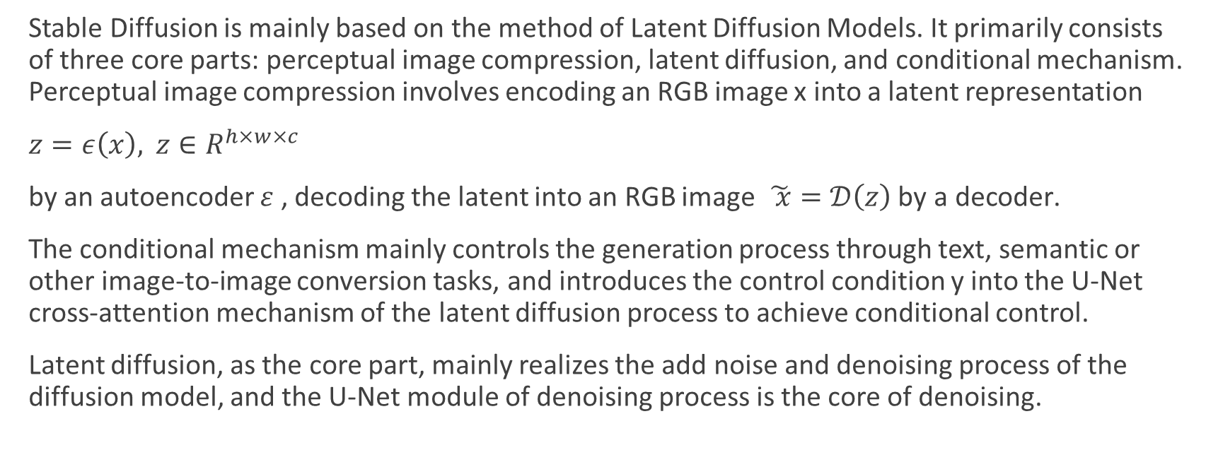
Stable Diffusion
Stable Diffusion is mainly based on the method of Latent Diffusion Models. It primarily consists of three core parts: perceptual image compression, latent diffusion, and conditional mechanism. Perceptual image compression involves encoding an RGB image x into a latent representation
$z=ε\left(x\right), z∈R^{h×w×c}$
by an autoencoder $ε$ , decoding the latent into an RGB image $\tilde{ x}=𝒟\left(z\right) \text{by} \text{a} \text{decoder}\text{.}$
The conditional mechanism mainly controls the generation process through text, semantic or other image-to-image conversion tasks, and introduces the control condition y into the U-Net cross-attention mechanism of the latent diffusion process to achieve conditional control.
Latent diffusion, as the core part, mainly realizes the add noise and denoising process of the diffusion model, and the U-Net module of denoising process is the core of denoising.

Slide 9
U – Net
U‑Net is a convolutional neural network with a distinctive U‑shaped design that first compresses an image into abstract features and then reconstructs it back to full resolution.
It combines encoder layers that capture high‑level semantics with decoder layers that restore spatial detail, while skip connections directly transfer fine information like edges and textures between the two paths.
In diffusion models, U‑Net is the core denoising engine: it takes noisy latent features and iteratively refines them into clean, coherent images.
The backbone branch emphasizes semantic alignment with prompts, while the skip branch preserves color, texture, and detail.
This balance makes U‑Net crucial for generating high‑quality text‑to‑image and text‑to‑video outputs, ensuring both meaning and visual fidelity

Slide 10
U-Net structure in diffusion model
The U-Net neural network structure is mainly used for medical image segmentation. The simple, efficient and stable network structure is not only widely used in the field of image segmentation, but also applicable to image denoising.
In the structure of the diffusion model, U-Net is the core module, which mainly performs iterative denoising of the Gaussian noise matrix in the diffusion cycle.
In the diffusion denoising process, text and timesteps guide each noise prediction. After iterative denoising, the random Gaussian noise matrix is finally transformed into the latent feature of the image.
The U-Net module in the diffusion model is a key factor in determining the quality of the generated results, such as T2I and T2

Slide 11
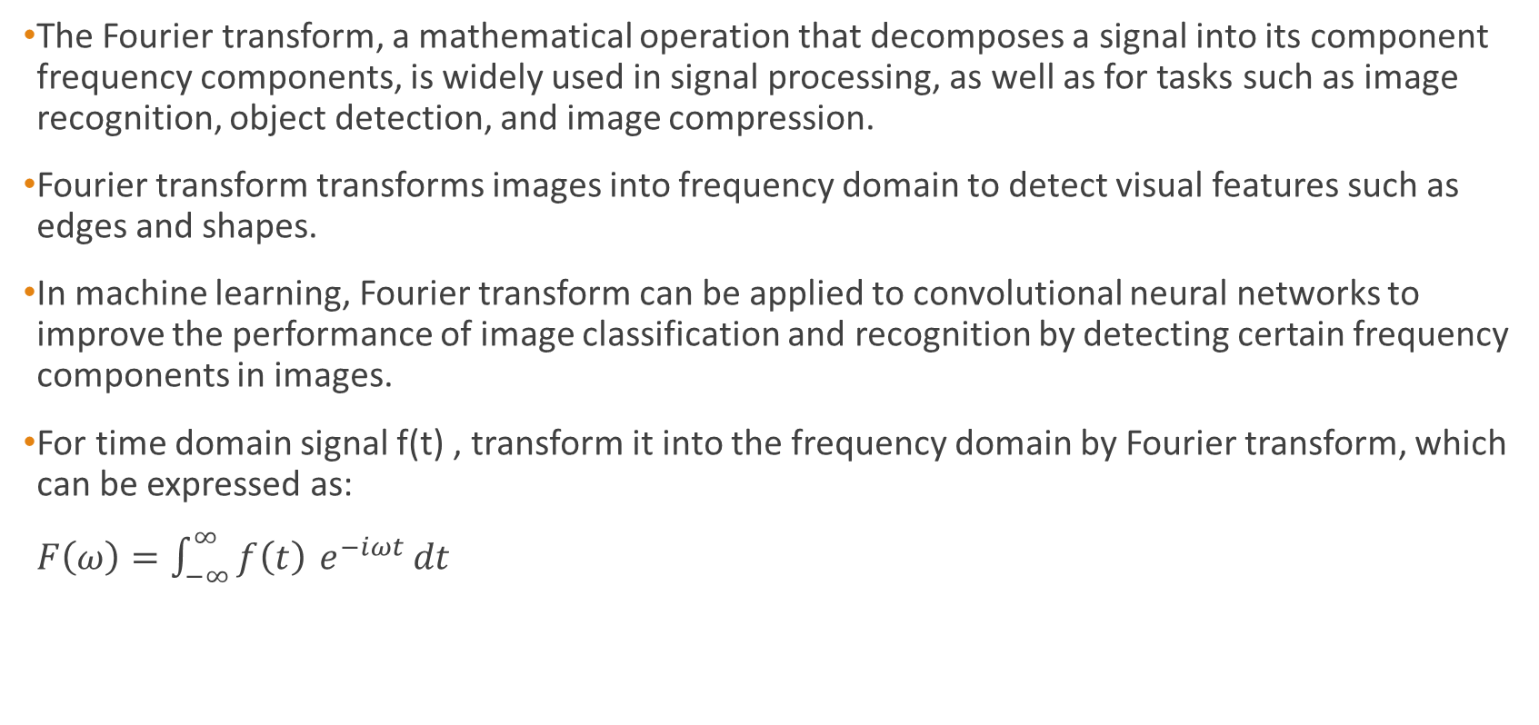
Fourier Transform
The Fourier transform, a mathematical operation that decomposes a signal into its component frequency components, is widely used in signal processing, as well as for tasks such as image recognition, object detection, and image compression.
Fourier transform transforms images into frequency domain to detect visual features such as edges and shapes.
In machine learning, Fourier transform can be applied to convolutional neural networks to improve the performance of image classification and recognition by detecting certain frequency components in images.
For time domain signal f(t) , transform it into the frequency domain by Fourier transform, which can be expressed as:
$F\left(ω\right)=\int_{−∞}^{∞}{f\left(t\right)} e^{−iωt} dt$

Slide 12
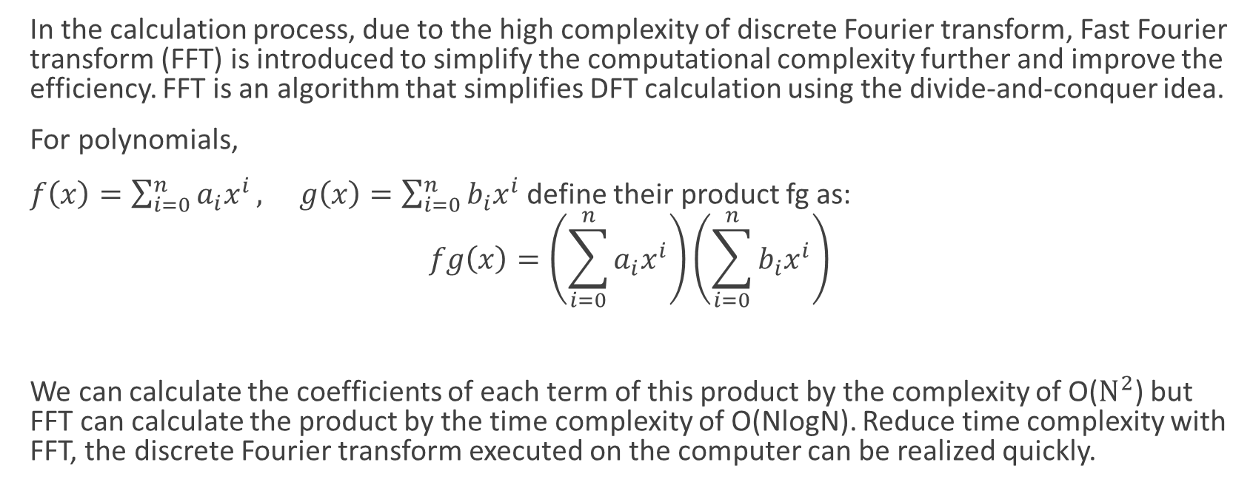
In the calculation process, due to the high complexity of discrete Fourier transform, Fast Fourier transform (FFT) is introduced to simplify the computational complexity further and improve the efficiency. FFT is an algorithm that simplifies DFT calculation using the divide-and-conquer idea.
For polynomials,
$f\left(x\right)=\sum_{i=0}^{n}{a_{i}x^{i}}, g\left(x\right)=\sum_{i=0}^{n}{b_{i}x^{i}}$ define their product fg as:
$$fg\left(x\right)=\left(\sum_{i=0}^{n}{a_{i}x^{i}}\right)\left(\sum_{i=0}^{n}{b_{i}x^{i}}\right)$$
We can calculate the coefficients of each term of this product by the complexity of O($N^{2}$) but FFT can calculate the product by the time complexity of O(NlogN). Reduce time complexity with FFT, the discrete Fourier transform executed on the computer can be realized quickly.

Slide 13
Amplitude and phase scaling in Fourier transform
In signal processing, by controlling the amplitude and phase of different frequency components of Fourier transform, a variety of signals with different waveforms can be synthesised. Similarly, in image processing, phase and amplitude can be utilized to describe image features. Phase can reflect an image’s texture and structure, whereas amplitude can reflect its brightness and contrast. The impact of scaling the amplitude and phase of different frequency components on T2I:
Low Frequency Components Scaling :
This approach preserves high-frequency details (edges, fine textures, sharp transitions) while selectively modifying low-frequency components (overall brightness, colour tone, global structure). This strategy proves particularly effective for enhancing semantic alignment and improving structural layout.

Slide 14
Characteristics of Low Frequency Amplitude:
Represents global illumination and broad colour distributions
Controls overall image brightness and tonal range
Influences perception of depth and three-dimensionality
Effects of Scaling Low Frequency Amplitude Reducing LF Amplitude (scale < 1.0):
Image Quality: Enhances local contrast while maintaining edge sharpness
Semantic Alignment: Improves text-to-image correspondence by reducing background dominance
Visual Effect: Creates more defined subject-background separation
Applications: Portrait enhancement, object isolation, semantic clarity

Slide 15
Increasing LF Amplitude:
Image Quality: Brightens overall appearance, may reduce local contrast
Visual Effect: Creates a softer, more uniform appearance
Trade-offs: May diminish semantic distinctiveness.
Low Frequency Phase Analysis
Characteristics of Low Frequency Phase:
Encodes global spatial relationships and compositional structure
Determines overall layout and object positioning
Controls gradual transitions and smooth colour gradients

Slide 16
Effects of Scaling Low Frequency Phase:
Structural Layout: Alters object positions and spatial arrangements.
Semantic Diversity: Generates varied compositions from identical prompts.
Text Alignment: Can improve or modify semantic correspondence.
Applications: Layout variation, compositional diversity, artistic interpretation

Slide 17
High Frequency Components Scaling
Characteristics of High Frequency Amplitude:
Represents edge strength and detail sharpness
Controls fine texture visibility and surface detail
Influences perceived image resolution and clarity
Effects of Scaling High Frequency Amplitude:
Increasing HF Amplitude:
Visual Clarity: Significantly enhances edge definition and detail visibility
Texture Quality: Improves surface texture richness and complexity
Semantic Expression: Strengthens object boundaries and feature distinctiveness
Applications: Detail enhancement, sharpness improvement, high-definition rendering

Slide 18
Reducing HF Amplitude:
Visual Effect: Smooths transitions, reduces noise.
Applications: Artistic softening, noise reduction.
Limitation: May sacrifice detail and clarity.
High Frequency Phase Analysis
Characteristics of High Frequency Phase:
Encodes precise edge locations and fine structural details
Determines texture pattern orientation and alignment
Critical for maintaining structural coherence at the detail level

Slide 19
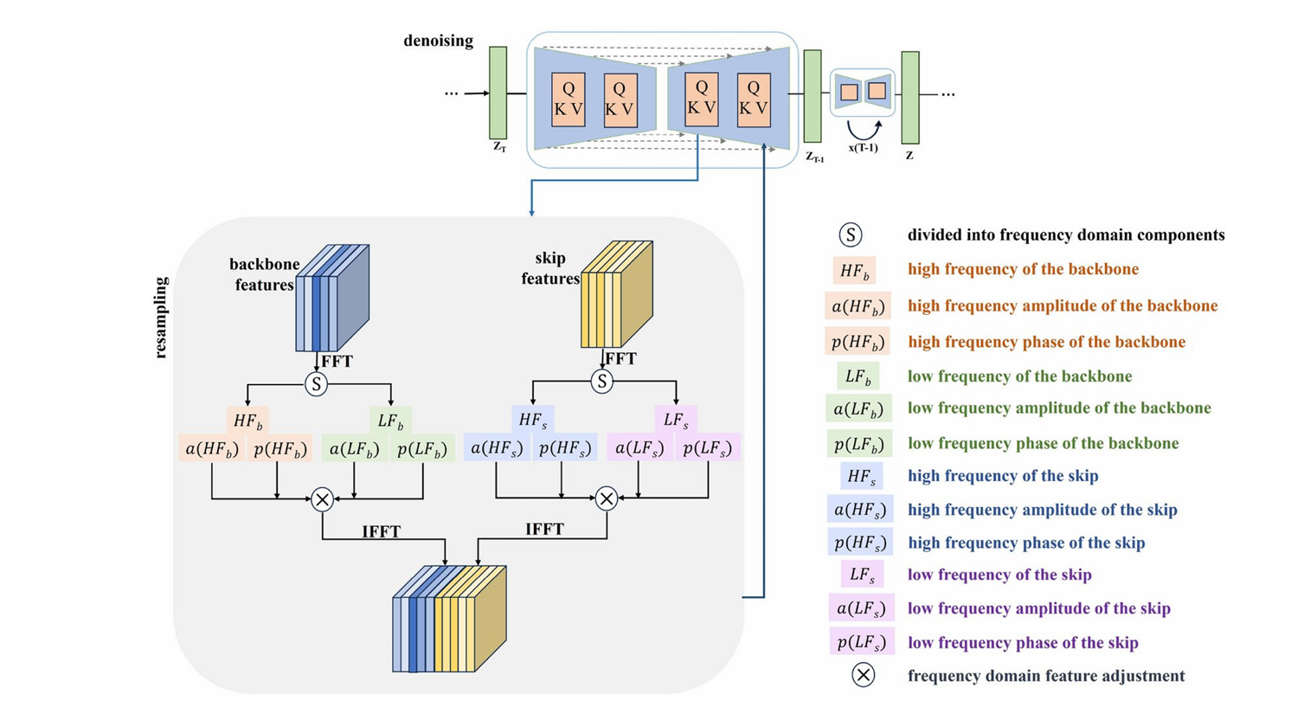

Slide 20
Text
U-Net sampling
Stable Diffusion
Image
Enhanced image
DMFFT applied AFTER
Workflow

Slide 21


Results
Generated Image
Enhanced Image

Slide 22
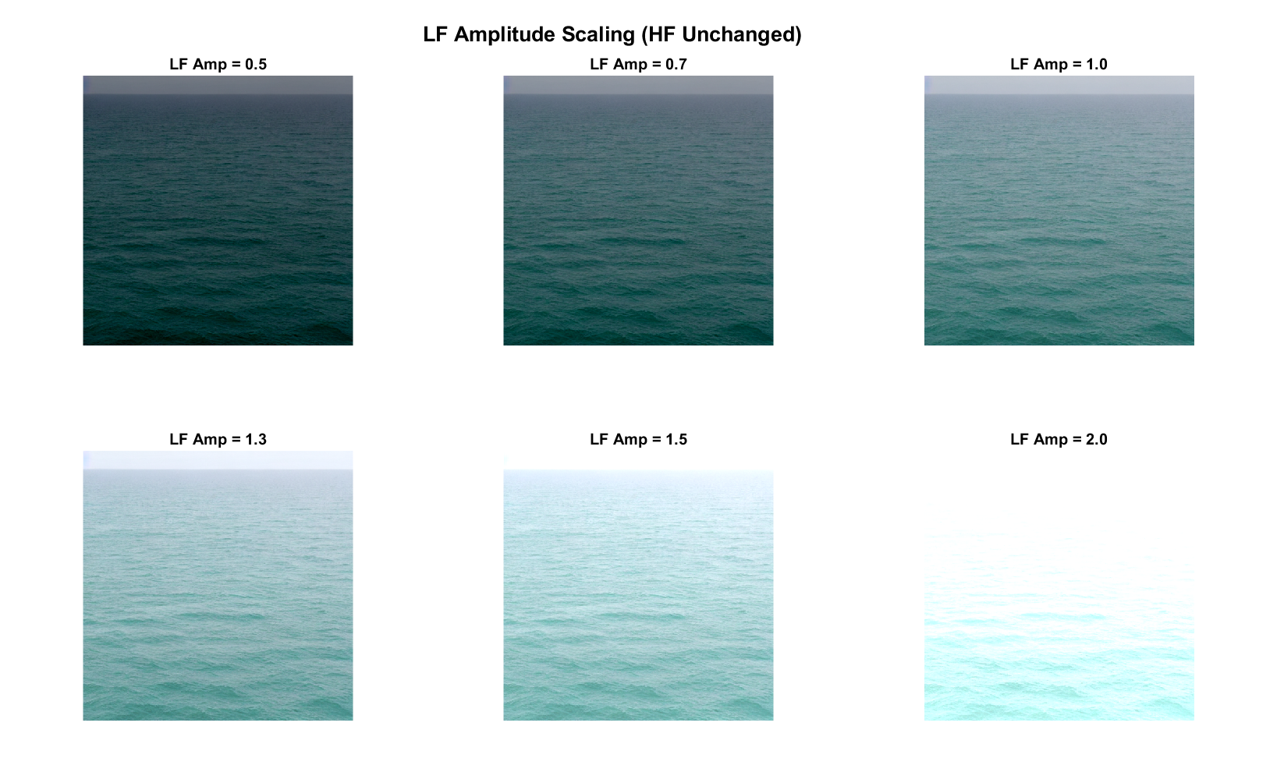

Slide 23
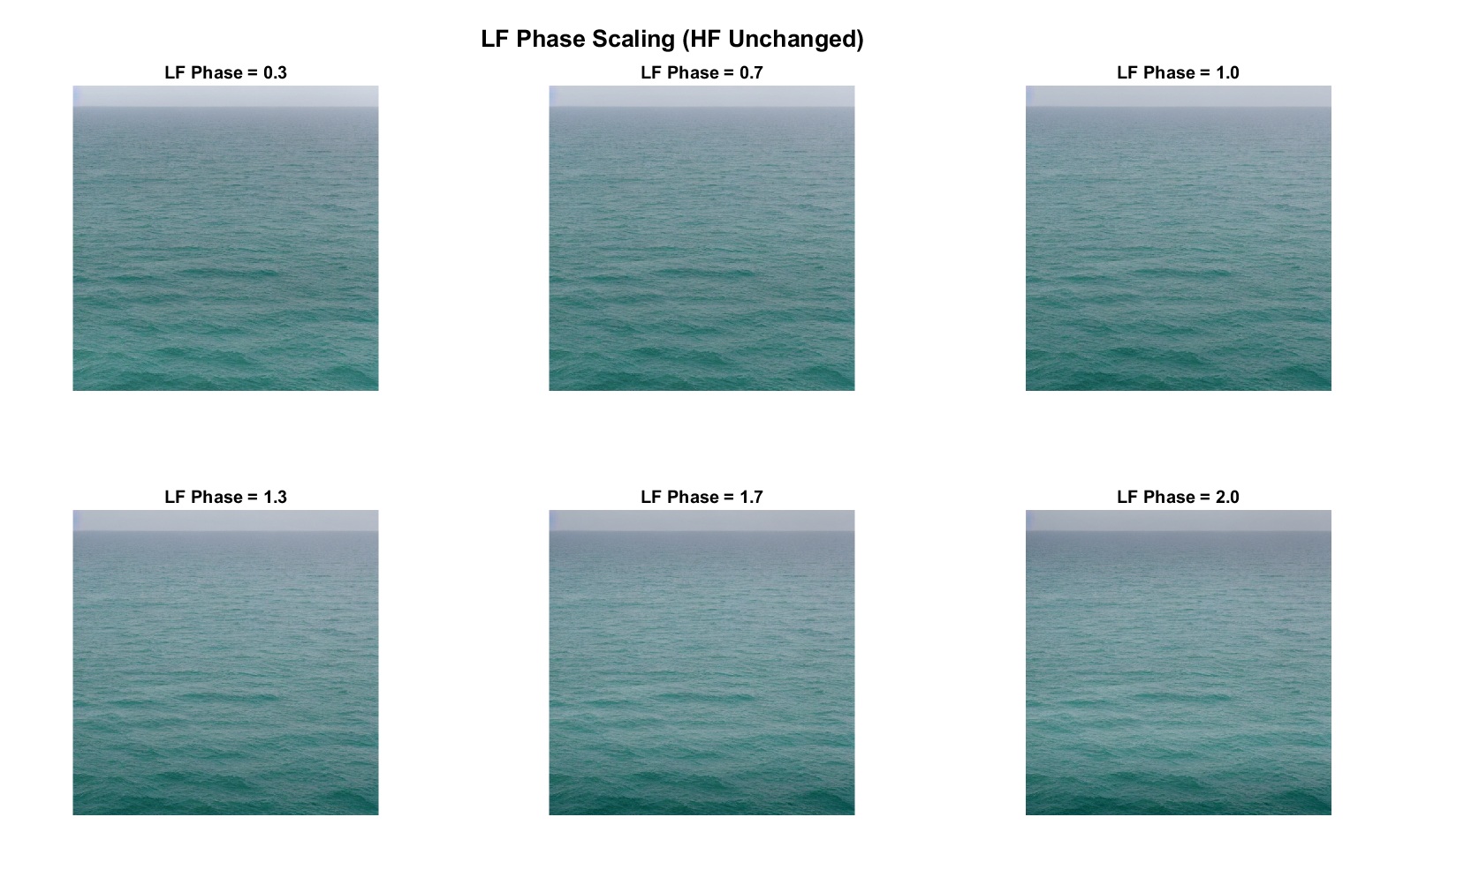

Slide 24
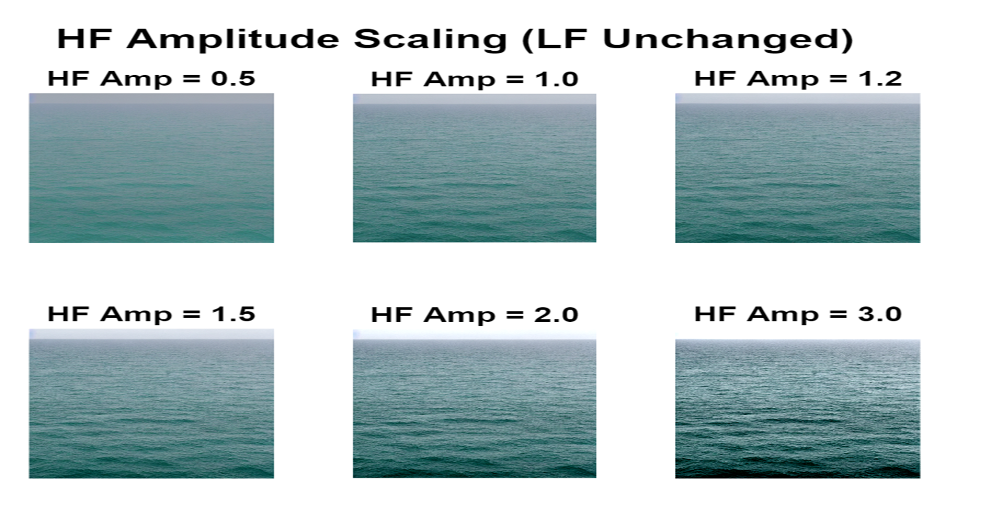

Slide 25
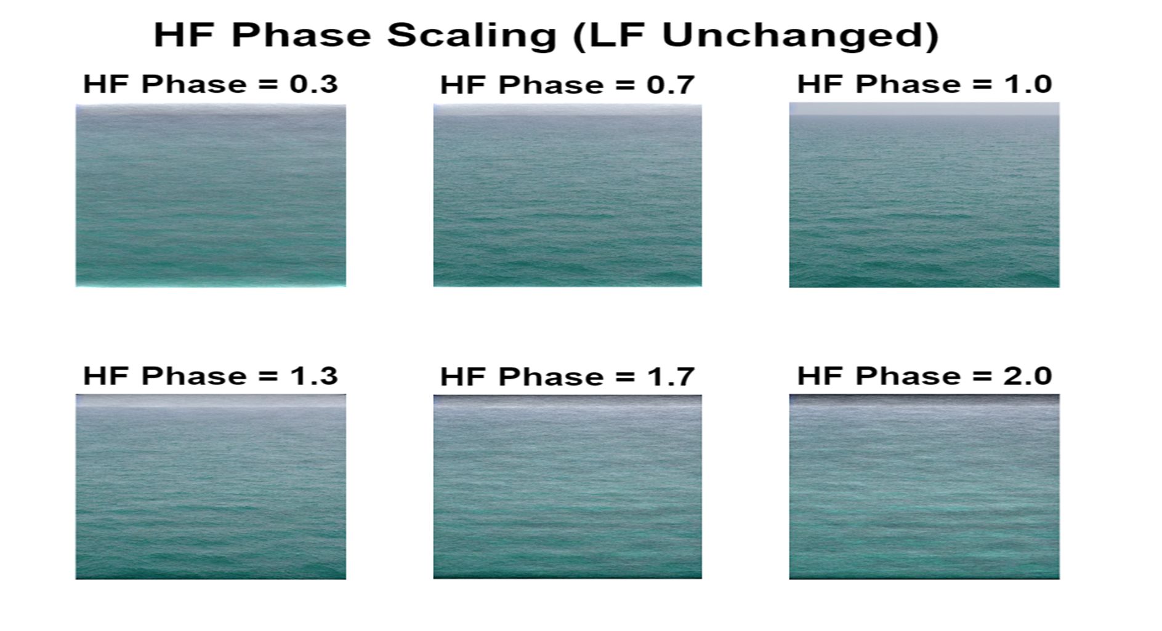

Slide 26
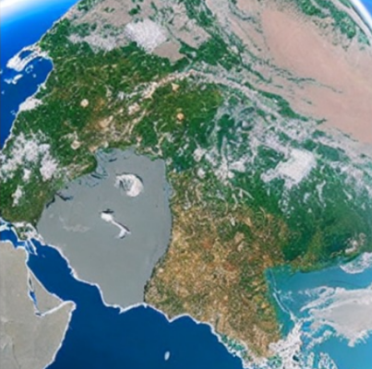
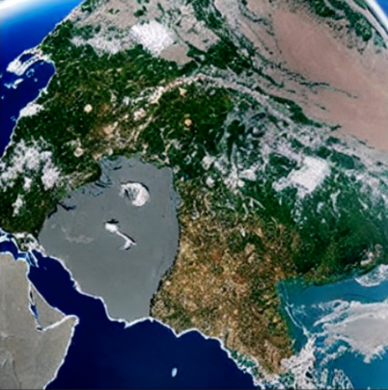
Generated Image
Enhanced Image

Slide 27


Generated Image
Enhanced Image

Slide 28
Conclusion
Successfully implemented DMFFT using Fourier transforms to enhance Stable Diffusion outputs, proving that mathematical methods improve AI generation without training or additional costs.
Confirmed LF scaling governs semantics/structure while HF scaling controls sharpness/texture through systematic parameter sweeps on real diffusion images.
Moderate values optimise photorealism; extreme values create stylised effects offering controllable enhancement from realistic to artistic without model modification.

